Slide 1
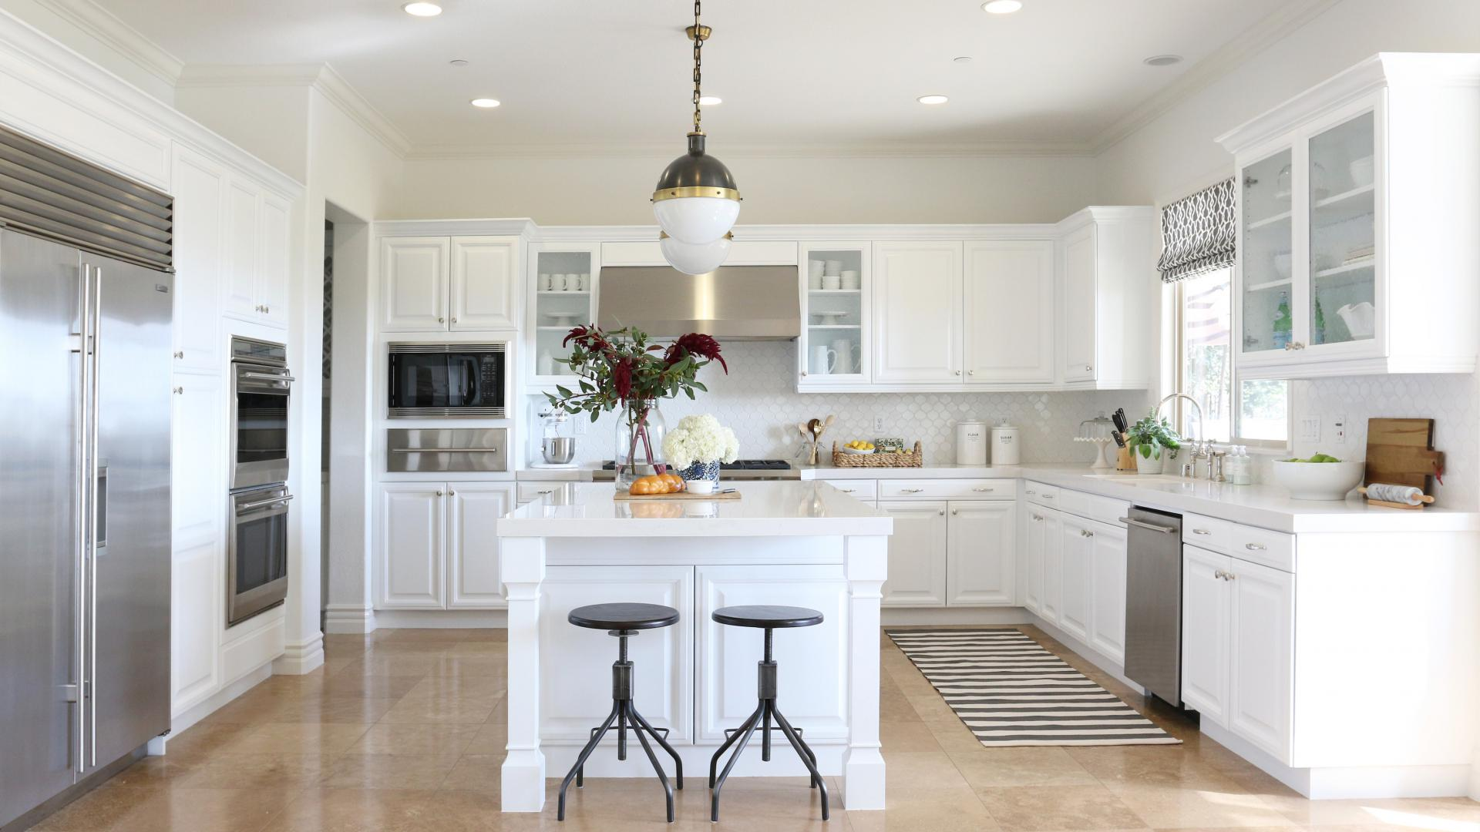

Slide 2
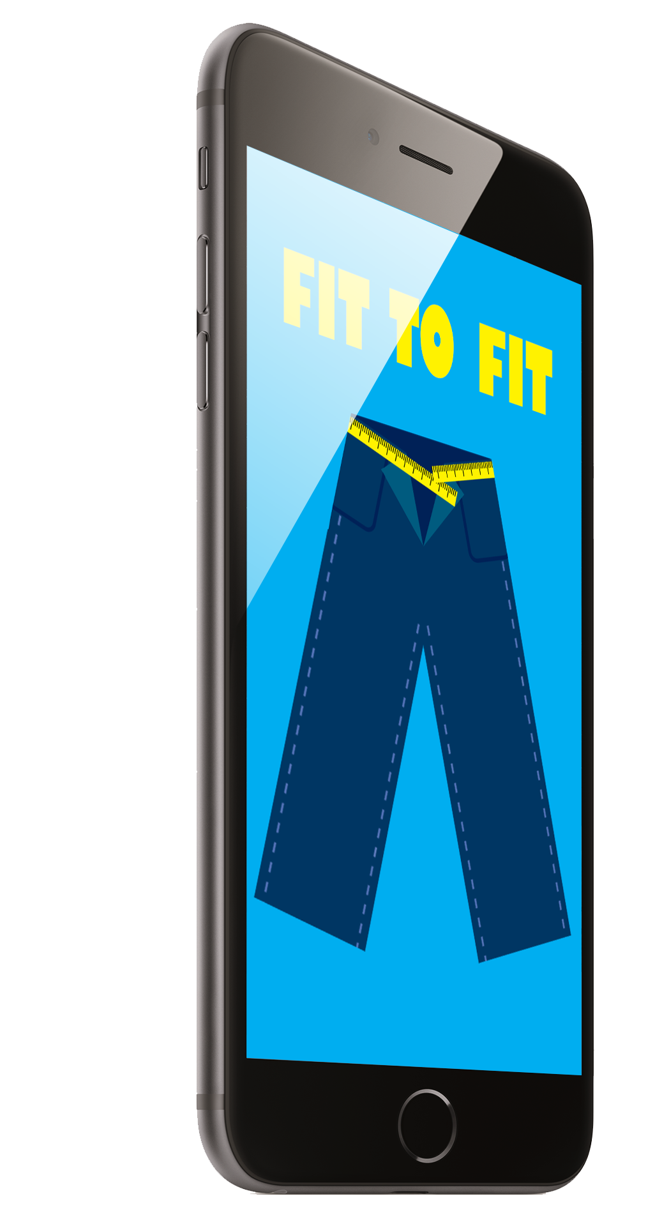
Fit to Fit
Ahmed Hussein
Subrata Kumar Lahiri
Hussein Abdullahi

Slide 3

Introduction
Audience: Adults
Combination of MyPlate application and UberEATS application will help obese individuals lose weight and live healthier.

Slide 4


Overview

Slide 5
v
Scenario

Slide 6
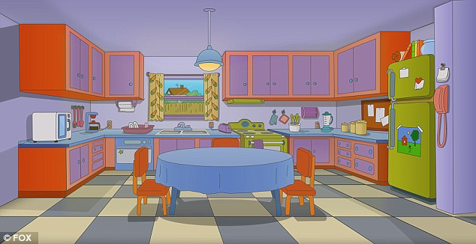

Scenario

Slide 7
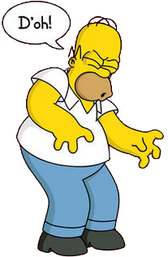
Scenario

Slide 8
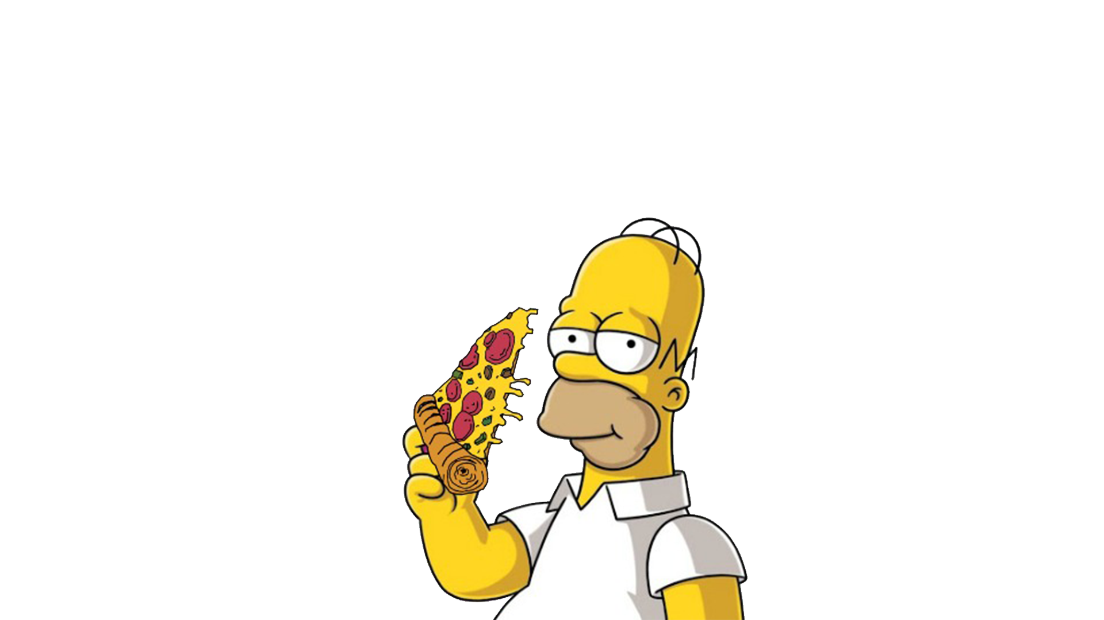
Order Food!

Slide 9
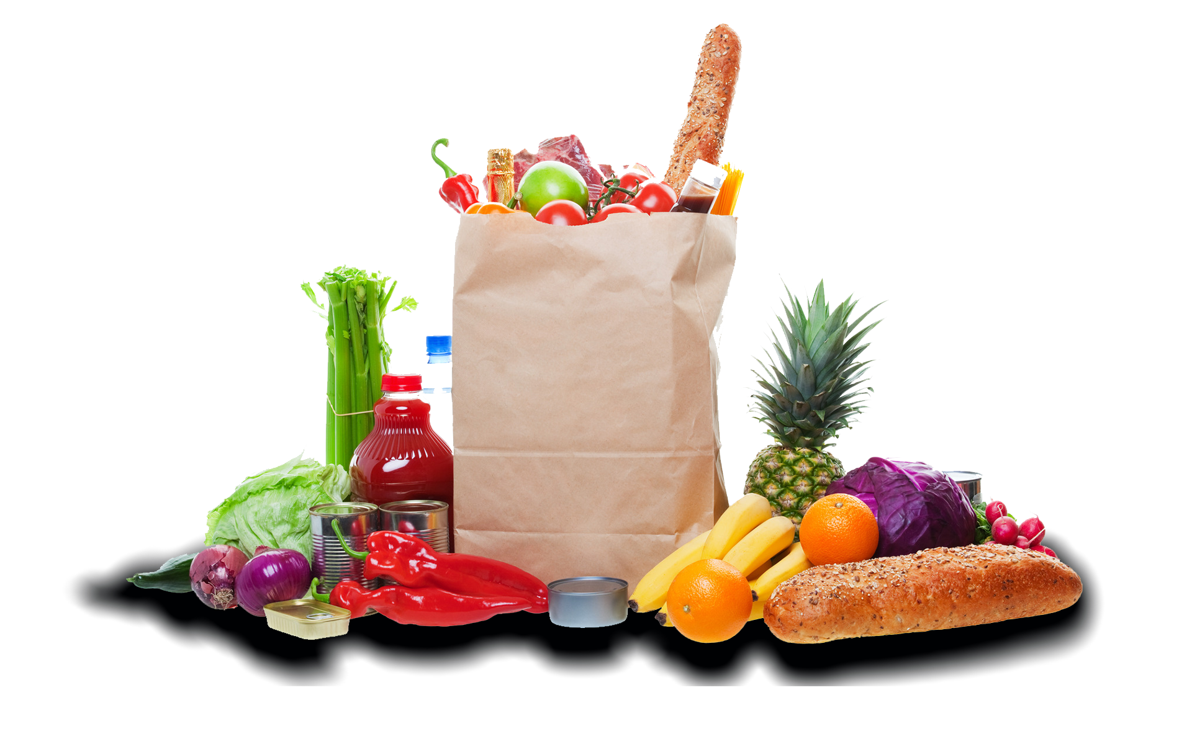
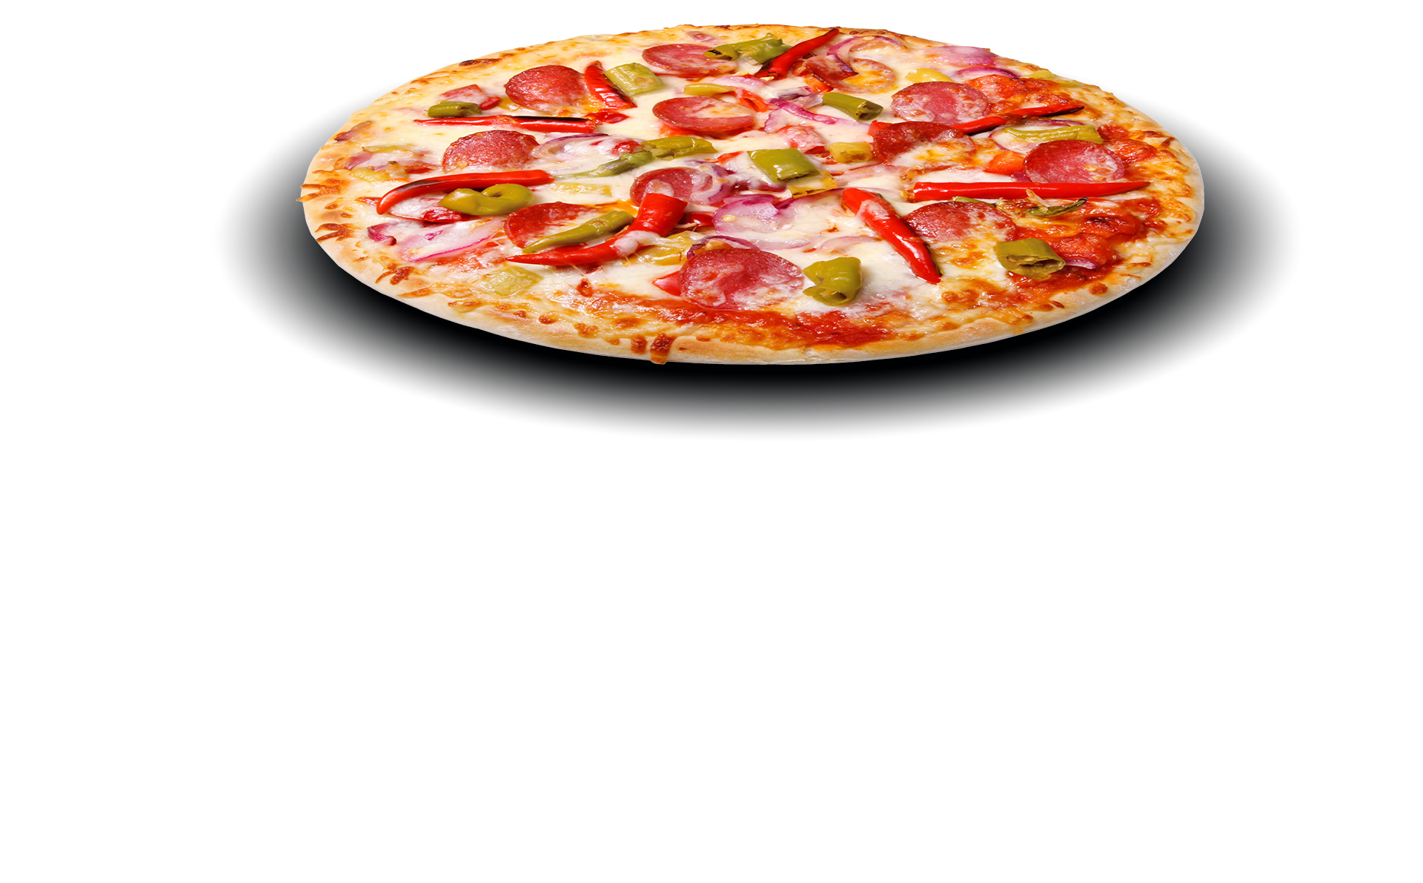
2 Choices?

Slide 10

2 Choices?
OUR IDEA

Slide 11
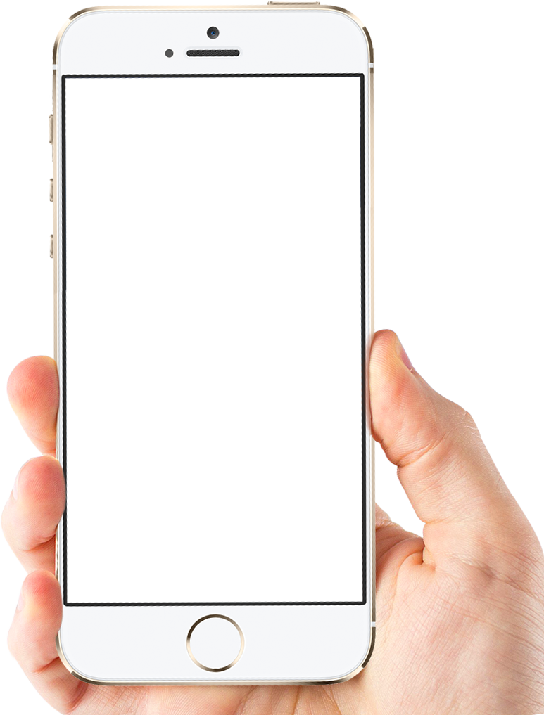
Current UberEATS:
Any participating restaurants (near-by)
Any type of food.
Get the food to your doorstep

Slide 12


Current MyPlate:
Contains calories tracking
Gives out encouraging plans
Nutritionist assistance program
Work out plans and/or tips

Slide 13

Combining UberEATS and MyPlate
Help people track their calorie intake
Limit the food options to healthy foods
Gives out encouraging plans
Nutritionist assistance program
No temptations
Get the healthy food to your doorstep

Slide 14
How do we get people interested?

Slide 15
How do we get people interested?
v
Through Peers!

Slide 16
Social Media
Can connect with friend
Find workout buddies
Follow Inspirations

Slide 17
Process that used to be ‘solo’…

Slide 18


Process that used to be ‘solo’…
can be done with friends!

Slide 19
Ugly Truth
Obesity costs a lot!

Slide 20


Slide 21
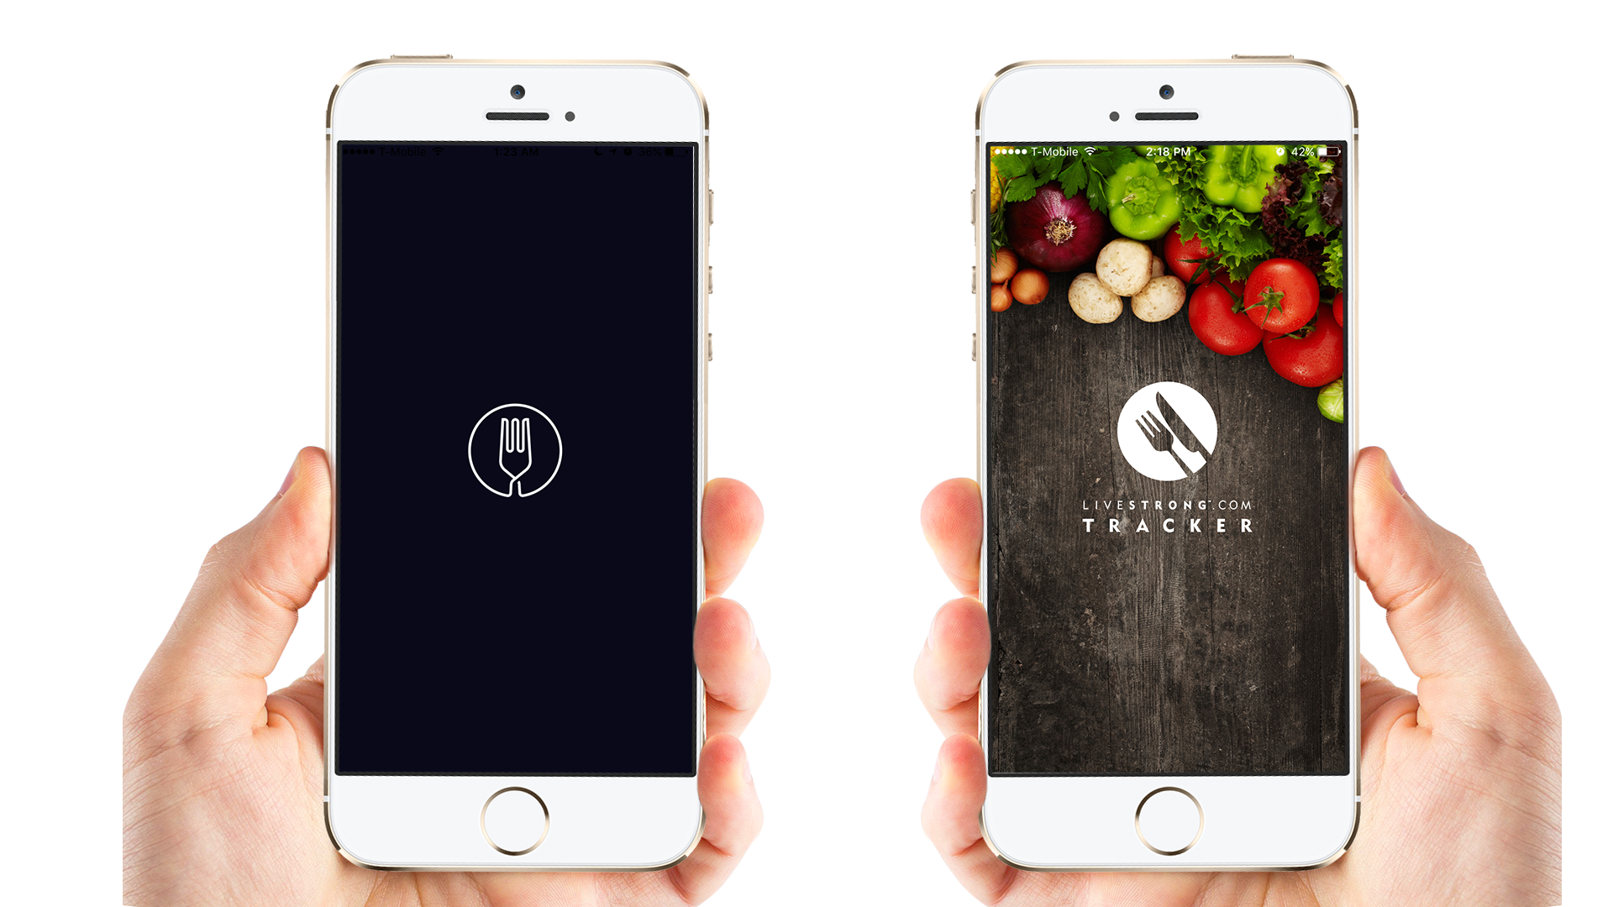

Slide 22
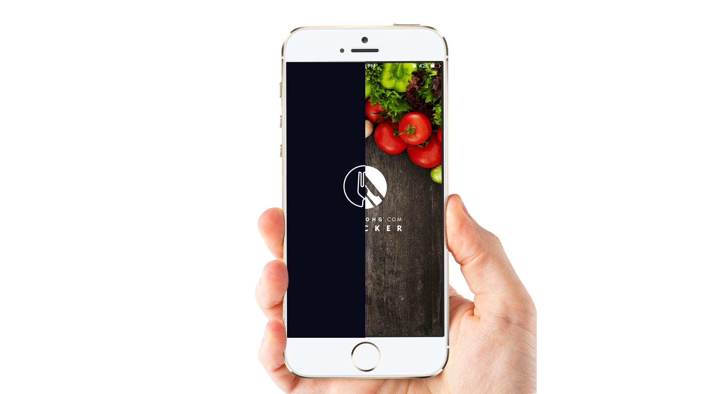

Slide 24
Thank You

